Slide 1
Climate Change Update – Climate change litigation in the U.S. Insurance implications
Richard Traub
Traub Lieberman Straus & Shrewsberry LLP

Slide 3
Climate vs. weather
The difference is a measure of time:
Weather = Conditions of the atmosphere over a short period of time.
Climate = how the atmosphere "behaves" over relatively long periods of time.

Slide 4
Brief history of climate change events
1712 - British ironmonger Thomas Newcomen invents the first widely used steam engine, paving the way for the Industrial Revolution and industrial scale use of coal.
1800 - World population reaches one billion.
1824 - French physicist Joseph Fourier describes the Earth's natural "greenhouse effect".
1886 - Karl Benz unveils the Motorwagen, often regarded as the first true automobile.
1927 - Carbon emissions from fossil fuel burning and industry reach one billion tons per year.
1930 - Human population reaches two billion.

Slide 5
1938 - Using records from 147 weather stations around the world, British engineer Guy Callendar shows that temperatures had risen over the previous century. He also shows that CO2 concentrations had increased over the same period, and suggests this caused the warming. The "Callendar effect" is widely dismissed by meteorologists.
1960 - Human population reaches three billion.
1975 - Human population reaches four billion.
1975 - US scientist Wallace Broecker puts the term "global warming" into the public domain in the title of a scientific paper.
1987 - Human population reaches five billion

Slide 6
1989 - UK Prime Minister Margaret Thatcher - possessor of a chemistry degree - warns in a speech to the UN that "We are seeing a vast increase in the amount of carbon dioxide reaching the atmosphere... The result is that change in future is likely to be more fundamental and more widespread than anything we have known hitherto." She calls for a global treaty on climate change. She was given the cold shoulder
1997 - Kyoto Protocol agreed. 192 parties pledge to reduce emissions by an average of 5% by the period 2008-12, with wide variations on targets for individual countries. US Senate immediately declares it will not ratify the treaty.

Slide 7
1998 - Publication of the controversial "hockey stick" graph indicating that modern-day temperature rise in the northern hemisphere is unusual compared with the last 1,000 years.
1999 - Human population reaches six billion.
2009 - China overtakes the US as the world's biggest greenhouse gas emitter - although the US remains well ahead on a per-capita basis.
2011 - Human population reaches seven billion.

Slide 8
2012 - Arctic sea ice reaches a minimum extent of 1.32 million sq. mi., a record for the lowest summer cover since satellite measurements began in 1979.
2015 – “Paris Agreement” signed by 195 countries. Only Nicaragua & Syria refuse. The parties agree, inter alia, to limit warming to “well below” 3.6 degrees F. (2 degrees Celsius), as measured from pre-industrial levels.
2017 – President Trump states that U.S. will pull out of the Paris Agreement, in keeping with his “America first” message. However, under terms of the Agreement, U.S. cannot withdraw until 11/4/2020, the day after the next presidential election.

Slide 9
U.S. Climate change litigation

Slide 10
Types of Claims
Federal Statutory Claims
Constitutional Claims
State Law Claims
Common Law Claims
Public Trust Claims
Security and Financial Regulation
Trade Agreements
Adaptation Cases
Cases Brought by Scientists and Protestors
Notes:
We obviously cannot cover the plethora of cases in each category. Instead, I will describe each category and discuss some of the more significant cases and claims.
Federal Statutory claims are just that, cases brought under statutory authority such as the clean air act, endangered species act, clean water act, and under NEPA the National Environmental Policy Act, which very generally requires environmental studies for any federal or state funded project. There are about 150 suite brought under this act the most recent against the Federal Energy Regulatory Commission challenging the authorization given to a natural gas infrastructure project in NY. Others include challenges to the sale of offshore oil and gas leases to a challenge to the US Army Corps of Engineers permits and authorizations for crude oil pipeline in Louisiana.
Constitutional claims include actions under the commerce clause of the US constitution, first amendment cases and so on. The commerce clause is general the opposite side of the argument ie. A challenge against Washington state officials for allegedly taking unlawful actions to block coal export terminal and other such challenges.
State Law Claims include FOIA requests, industry lawsuits, environmentalist lawsuits and enforcement cases. There are a couple of hundred of these. Industry lawsuits are brought by industry such as Exxon Mobil seeking pre-suit discovery in advance of anticipated claims; Challenges by power companies to regulations and the like. On the other side, there are numerous cases brought by young people against the government for taking inadequate action to protect them against climate change. More on that later.
Common Law Claims – these are the ones you are probably thinking about. For example, a case by the City of NY against fossil fuel companies seeking damages for climate change related injuries. Adaptation cases are similar – they include actions seeking money damages for losses to insurance cases – cases brought by insurers contending they have to make larger payments to property owners who suffered flooding as a result of gov. failures and in others seeking DJ that they are not obligated to defend or indemnify policy holders in actions seeking climate related damages.

Slide 11
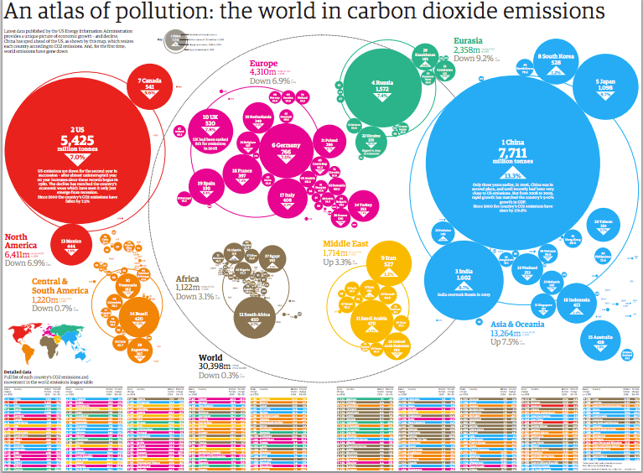
Liability for climate change
Standing and Political Question.
Judges barred from imposing their own limits on GHG emissions.
Clean Air Act supersedes and federal common law.
No common law claim of nuisance.
Notes:
Two primary barriers to litigation over climate change – Standing and political question. Standing limits juris. In the fed courts to cases or controversies which in turn means you must show injury in fact i.e. causation and redressability. That is, the relieve sough would remedy the injury. Causation is the tough part. How can one show that his or her crops were destroyed by climate change vs. random event or that defendant’s specific GHG’s contributed to same.
Political question doctrine asks whether there is a justiciable claim, that is, the courts will not interfere with the business of other branches of government. As such, judges cannot impose their own limits on GHG emissions separate from those imposed by the EPA. So says the clean air act.
Comer v. Murphy Oil – Fed Ct. in Miss held that those suffering from client change could not assert claims based on Fed common law of nuisance seeking $ damages (as opposed to injunctive relief) or state claims. That plaintiff sued Murphy Oil arguing in tort (nuisance, trespass & negligence) that it emitted GHG’s in such amounts that it caused the oceans to warm, Katrina to intensify, rising sea levels, that aggravated its impact. Court held that this was left to the CAA. S.CT refused to hear.
Another case Kivalina v. ExxonMobil. Lawsuit on theory of nuisance claiming $ damages from the energy industry for the destruction of Kivalina, Alaska by flooding caused by climate change. Suit was dismissed by the USDC holding that regulation of greenhouse gases was a political issue not a legal issue that had to be resolved by congress. Lost on appeal and S.Ct. refused to hear.

Slide 12
Exxonmobil
But now, a trove of ExxonMobil documents have created litigation much like tobacco. You hid your knowledge
Cases now seek to hold the fossil fuel industry accountable for damages they foresaw decades ago
The industry have profited from fossil fuels but has not absorbed the economic costs of the consequences.
Following is a summary of the major legal battles against the oil and gas industry

Slide 13
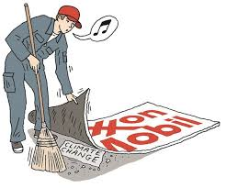
Where the major climate changes lawsuits stand today
Numerous legal challenges against the oil and gas industry after revelations that ExxonMobil long recognized the threat fossil fuels pose to the world.
Two states and V.I. have brought fraud investigations into Exxon over climate change.
In 2015 “Our Children’s Trust filed a suit asserting that the federal gov. is failing to protect them from climate change

Slide 14
NY, MA, and USVI
Brought investigations of Exxon starting in 2015.
Exxon fired back with massive legal barrage and USVI pulled out.
Has sued NY and MA to block investigations on basis they were politically motivated
NY court denied Exxon motion to keep PWC accounting records secret.
As of April this year, the investigations continue and Exxon’s suit has been transferred from Texas to NY

Slide 15
Cities sue of climate change
Faced with huge potential losses due to rising sea levels, 8 cities and counties in CA, along with NYC, and municipalities in CO and Washington filed suit against oil and gas companies.
They assert a public nuisance claim, negligence in that they have been burning fossil fuels for decades which is one of the biggest contributors to global warming – and hid knowledge of the risk.
In CA, millions are sought for mitigation measures including construction of sea walls. Industry response has been to seek to move to Fed Ct. where nuisance claims are tougher to prove.
In March 2018 Federal Judge hosts climate change tutorial for the court. Statements given by Chevron, BP, Shell and Conoco Phillps
April, City of Boulder filed suit
May 2018 Rhode Island filed suit.
June 2018 Federal Judge dismisses SF and Oakland cases saying that while climate change dangers are very real, the issues should be solved by Congress.
July 2018 Federal Judge dismisses NYC lawsuit saying that climate change has to be dealt with by Congress or President and not the Courts.

Slide 16
Children’s climate lawsuits
Our Children’s Trust – commenced in 2015 relies on the public trust doctrine – Juliana v. US
Does not rely on written laws such as the clean air act, it relies argues deprivation of rights to life, liberty and property found in the 5th Amendment. (Due Process clause)
Problem is that while climate change is real, the fault clearly does not lie with one country and its actions nor for that matter with one industry.
Trial was set for October 29, 2018 in Eugene, Oregon.
Nobel economist Joseph Stiglitz supports children’s case as expert
In July, 2018 Fed. Appeals court reject request to end the lawsuit and the US Supreme Court rejects an emergency stay.
9th Circuit to hear interlocutory appeals on refusal to dismiss (June 2019)
But it still inspired others – youth in Netherlands won their case that the Dutch gov. Was negligent in not properly regulating and minimizing greenhouse gas emissions .
Two other cases in Pakistan and India are awaiting further actions;
Notes:
The next generation is likely to be stuck with managing the physical, ecological and economic fallout of climate change.
Public Trust doctrine is a legal canon that stresses the governments hold on resources such as land, water or fisheries as treasure for the people. These lawsuits seek to extend that principle by asserting that government is also a trustee of the atmosphere. As such, they argue that the gov. is not doing enough to address climate change, which in turn is a violation of their constitutional rights.

Slide 18
Impact on the insurance industry
The cost of climate change are increasing and substantial. 2017 was the costliest year on record for natural catastrophic events with $344 Billion in global economic loss, of which 97% were weather related.
Insured losses totaled $140 Billion
IPCC Special Reports projects that by 2100 damages will exceed $54 Trillion with a 1.5 degree Celsius (2.7 degree Fahrenheit) increase in temperature. That increases to $69 Trillion with an increase of 2.0 degrees Celsius.

Slide 19
Potential credit rating downgrades for coastal municipalities given sea level projections and escalation of flood insurance premiums
Direct damage to real and personal property
Cost to mitigate sea level rise
Impact on biological systems (humans, vegetation, wildlife)
Loss of natural resources (wildfires, submergence of sensitive wetlands, coral reefs and impacts on fish and wildlife
Increase in waterborne pests and associated disease
Business interruption and loss of income
Impact to national security

Slide 20
Coverage
Dearth of cases, but will likely change
Increased litigation activity by municipalities and private parties against fossil fuel companies impact GL, D & O, and Property insurance.
Coverage issues will include: Do climate change suites seek “damages”; “property damage”; was the damage during the policy period (trigger); occurrence; allocation; and pollutant exclusions
AES Corp. V. Steadfast Ins. Co., 725 S.E. 2d 532 (Va. 2012) is the only reported decision involving coverage for climate change liabilities. VA S.Ct. held insurer has no obligation to defense or cover for the insured’s potential climate related liabilities arising from the Native Village of Kivalina suit. Disposed of on lack of occurrence issue (allegation was that insured intentionally releases tons of CO2 and GHGs into the atmosphere)

Slide 21
Closing thoughts
In 2018 Allianz announced it would no longer insure both single fired coal power plants and all planned and operating coal mines.
Swiss Re, Munich Re, AXA and Zurich have all opted to limit insurance dealings with coal
Lloyd’s Banking Group announced that it will refuse to finance new clients whose revenues predominantly come from coal power plants and mines.
Climate is changing and quickly – there is no dispute
The cost will eclipse the GDP of many developed countries
Lawsuits against fossil fuel companies and other carbon producers will proliferate
Suits by stakeholders against public companies and directors and officers will grow as well.

Slide 22
To date, underlying plaintiffs have been unsuccessful. Federal courts have dismissed these on justiciability, preemption and/or standing holding that the Clean Air Act supplants any private cause of action for common law nuisance and it is therefore up to the EPA to regulate GHG’s and not the courts.
However, a number of appeals are pending and the big ten cases are in various states of motions to dismiss and are pending in different states before differing judges.
Even if they are dismissed, defense costs will be significant.
ILS including Cat bond issuance will almost certainly grow as a vehicle to hedge against uncertain climate related liability

